Slide 1
L03: Markov Decision Processes (MDPs) II (slides from Berkeley CS188)

Slide 2
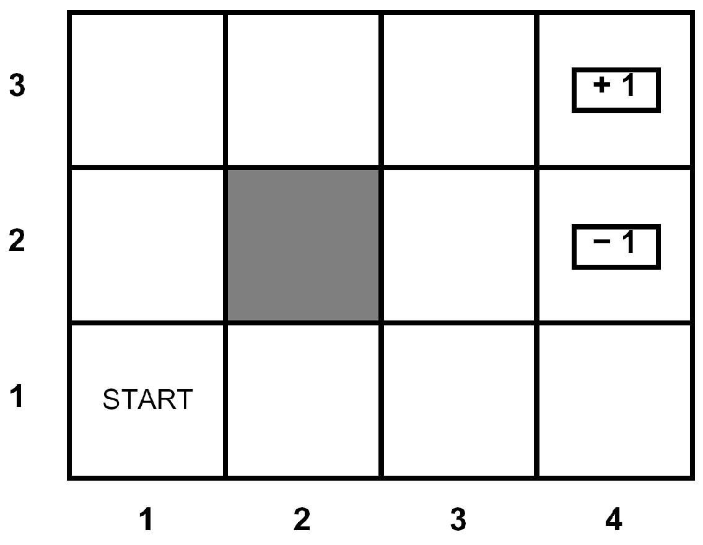
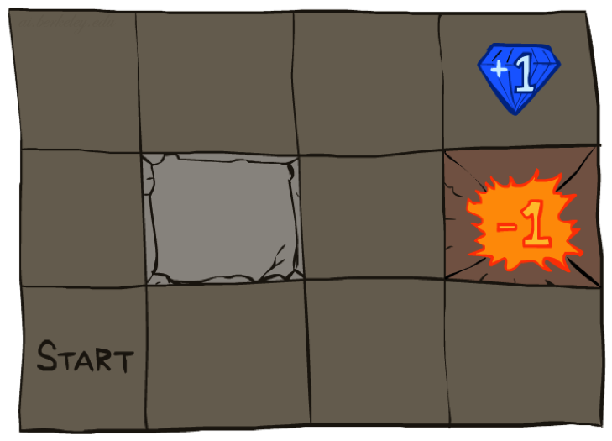




Example: Grid World
A maze-like problem
The agent lives in a grid
Walls block the agent’s path
Noisy movement: actions do not always go as planned
80% of the time, the action North takes the agent North
10% of the time, North takes the agent West; 10% East
If there is a wall in the direction the agent would have been taken, the agent stays put
The agent receives rewards each time step
Small “living” reward each step (can be negative)
Big rewards come at the end (good or bad)
Goal: maximize sum of (discounted) rewards
Notes:
[cut demo of moving around in grid world program]

Slide 3
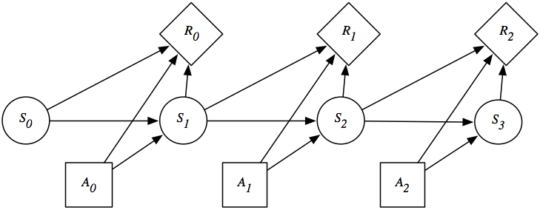
Recap: MDPs
Markov decision processes:
States S
Actions A
Transitions P(s’|s,a) (or T(s,a,s’))
Rewards R(s,a,s’) (and discount γ)
Start state s₀
Quantities:
Policy = map of states to actions
Utility = sum of discounted rewards

Slide 4
Optimal Quantities
The value (utility) of a state s:
V*(s) = expected utility starting in s and acting optimally
The value (utility) of a q-state (s,a):
Q*(s,a) = expected utility starting out having taken action a from state s and (thereafter) acting optimally
The optimal policy:
π*(s) = optimal action from state s
s
s is a state
a
(s, a) is a q-state
s, a
s,a,s’
(s,a,s’) is a transition
s’
Notes:
Demo just shows V and Q values, snapshots on next slides.

Slide 5
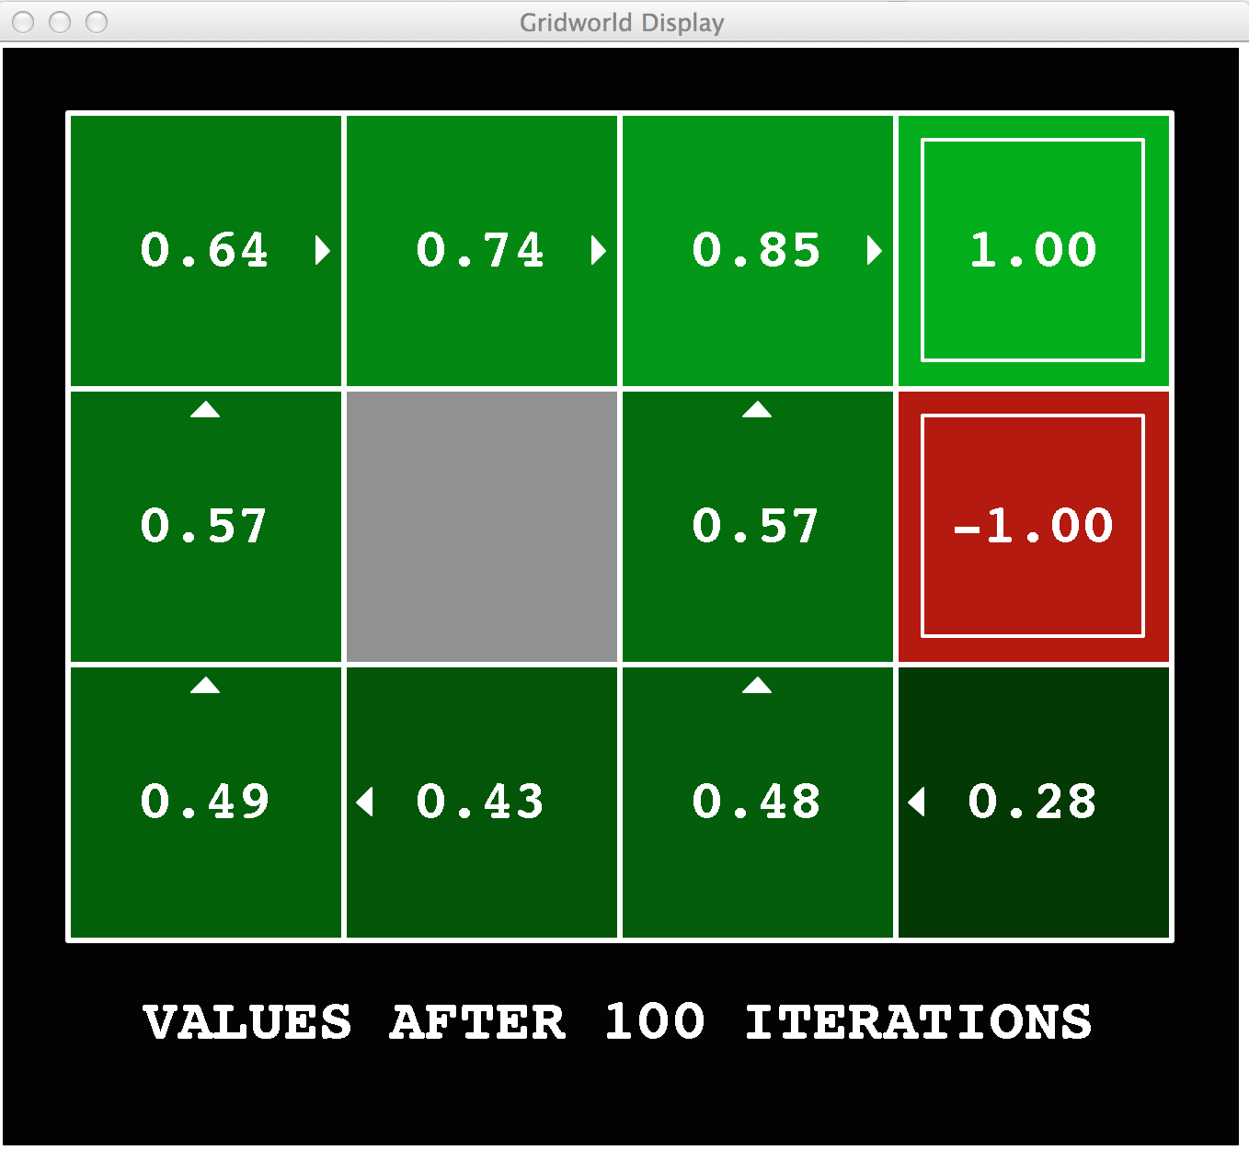
Gridworld Values V*

Slide 6
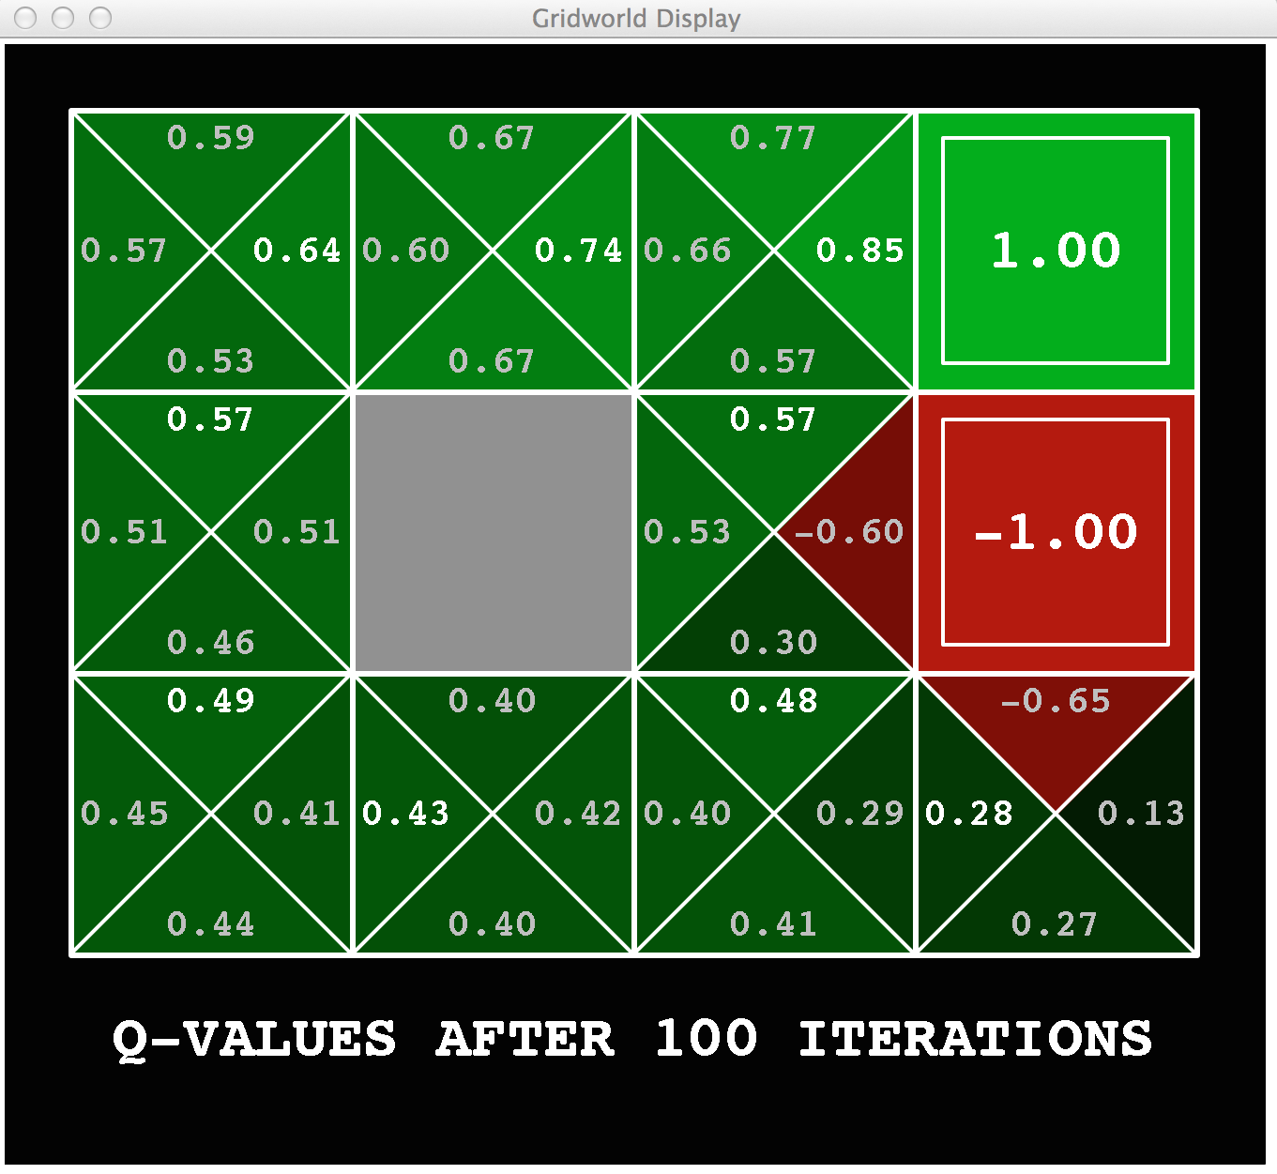
Gridworld: Q*

Slide 7
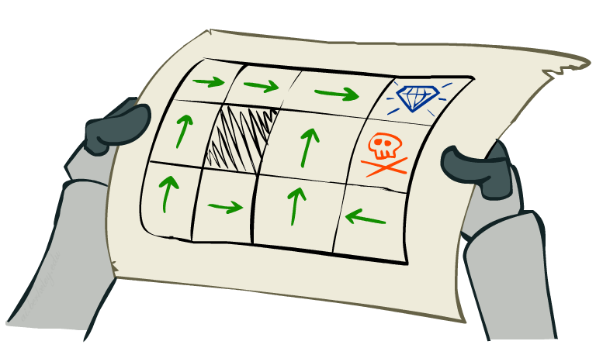
Solving MDPs

Slide 8

The Bellman Equations
How to be optimal:
Step 1: Take correct first action
Step 2: Keep being optimal

Slide 9

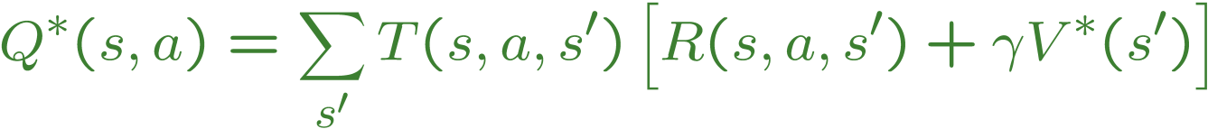
The Bellman Equations
Definition of “optimal utility” via expectimax recurrence gives a simple one-step lookahead relationship amongst optimal utility values
These are the Bellman equations, and they characterize optimal values in a way we’ll use over and over
s
a
s, a
s,a,s’
s’
Notes:
Let’s start by equations that characterize these quantities through mutual recursions. [step through this by writing on slide, one step at a time]
Recursive characterization of V* in terms of V*; not necessarily helpful; but it is a characterization.
Note: this is a set of equations that needs to be satisfied; but it could have multiple solutions (it does not, but at this stage of our knowledge it could).

Slide 10
Value Iteration
Bellman equations characterize the optimal values:
Value iteration computes them:
Value iteration is just a fixed point solution method
… though the V_{k} vectors are also interpretable as time-limited values
V(s)
a
s, a
s,a,s’
V(s’)
Notes:
Discuss computational complexity: S * A * S times number of iterations
Note: updates not in place [if in place, it means something else and not even clear what it means]

Slide 11
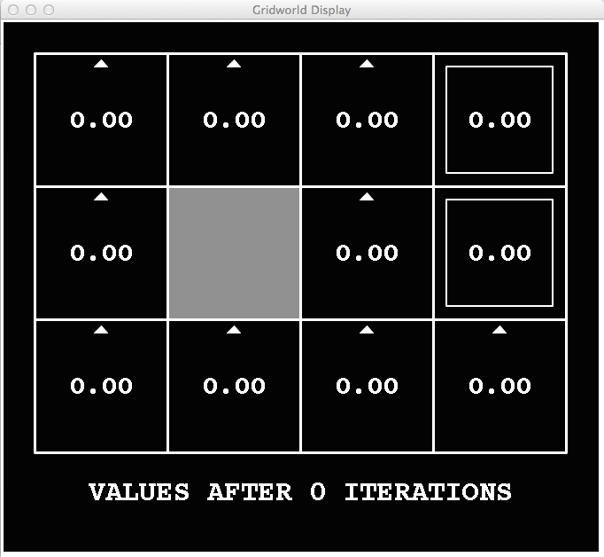
k=0
Noise = 0.2
Discount = 0.9
Living reward = 0
Notes:
Assuming zero living reward

Slide 12
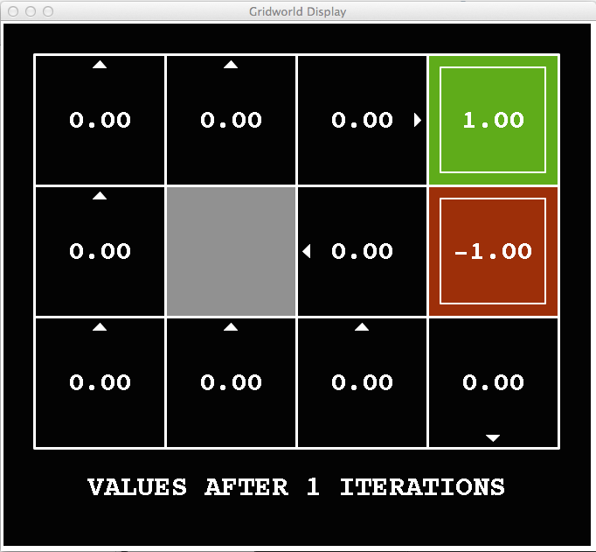
k=1
Noise = 0.2
Discount = 0.9
Living reward = 0
Notes:
Assuming zero living reward

Slide 13
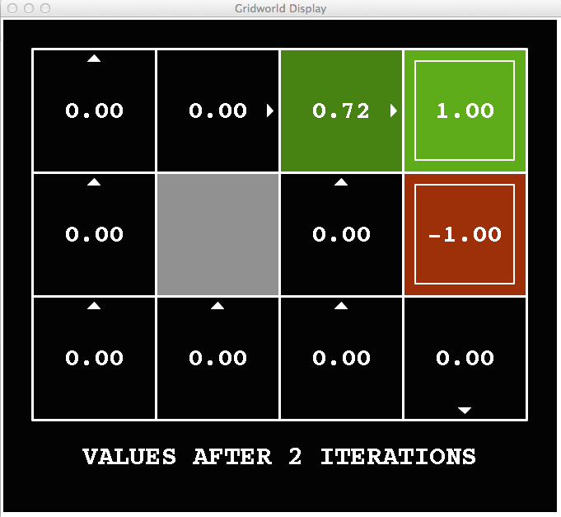
k=2
Noise = 0.2
Discount = 0.9
Living reward = 0
Notes:
Assuming zero living reward

Slide 14




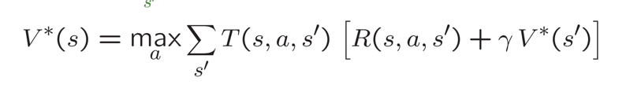
k=2
Noise = 0.2
Discount = 0.9
Living reward = 0
R = 0
R = 0.9
=0.8*[0+0.9*1]
=1
=0.8*0.9
=0.8
=0.72
Notes:
Assuming zero living reward

Slide 15
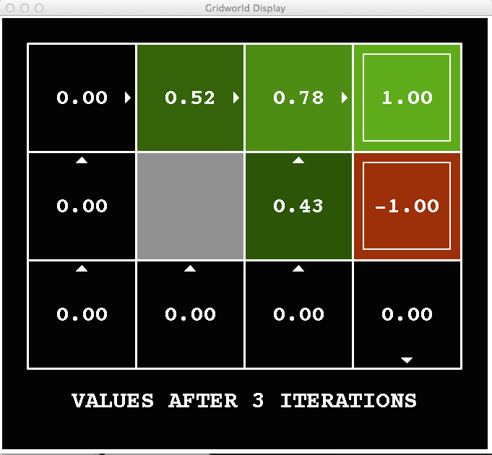
k=3
Noise = 0.2
Discount = 0.9
Living reward = 0
Notes:
Assuming zero living reward

Slide 16





k=3
k=2
Pour le 0.52 ?
0.8
0
=0.8.[0+0.9*0.72]
0.9
=0.8.[0+0.648]
0.72
=0.8.[0+0.648]
=0.518
Noise = 0.2
Discount = 0.9
Living reward = 0
Notes:
Assuming zero living reward

Slide 17
k=3
k=2
Pour le 0.43 ?
0.8
0
=0.8.[0+0.9*0.72] +
0.1 .[0+0.9*(-1)]
0.9
0.72
=0.518 -0.09
(en haut)
-1
=0.428
(à gauche)
Noise = 0.2
Discount = 0.9
Living reward = 0
Notes:
Assuming zero living reward

Slide 18
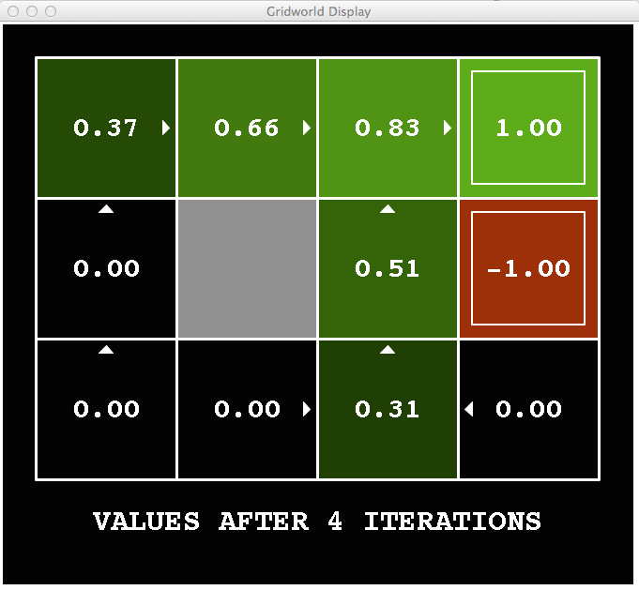
k=4
Noise = 0.2
Discount = 0.9
Living reward = 0
Notes:
Assuming zero living reward

Slide 19
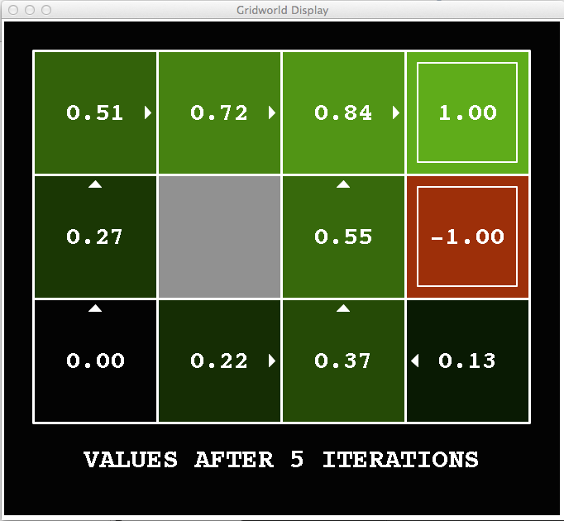
k=5
Noise = 0.2
Discount = 0.9
Living reward = 0
Notes:
Assuming zero living reward

Slide 20
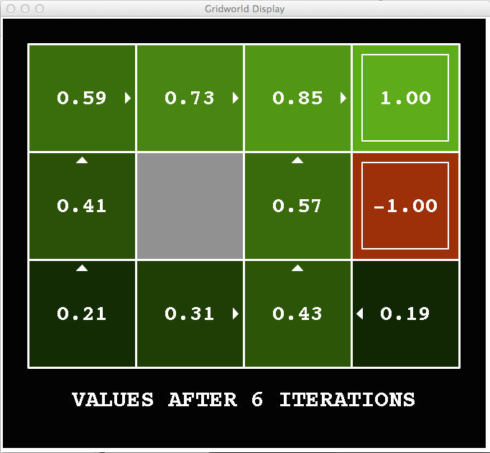
k=6
Noise = 0.2
Discount = 0.9
Living reward = 0
Notes:
Assuming zero living reward

Slide 21
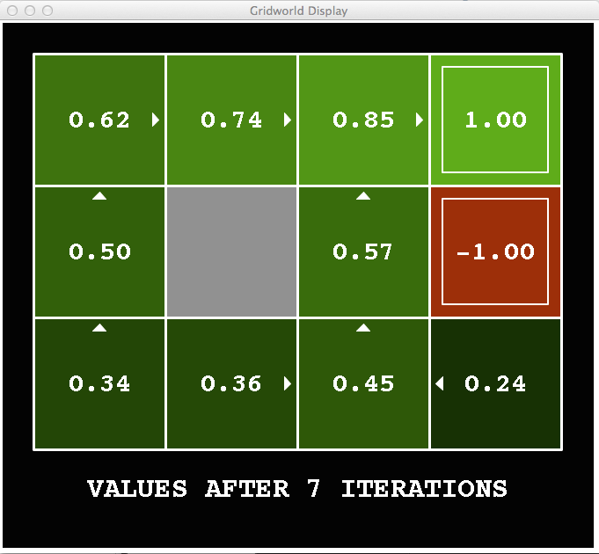
k=7
Noise = 0.2
Discount = 0.9
Living reward = 0
Notes:
Assuming zero living reward

Slide 22
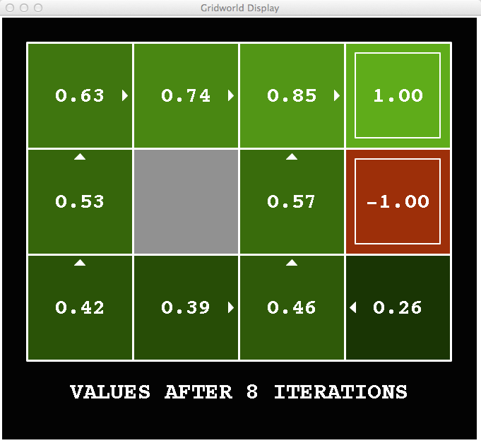
k=8
Noise = 0.2
Discount = 0.9
Living reward = 0
Notes:
Assuming zero living reward

Slide 23
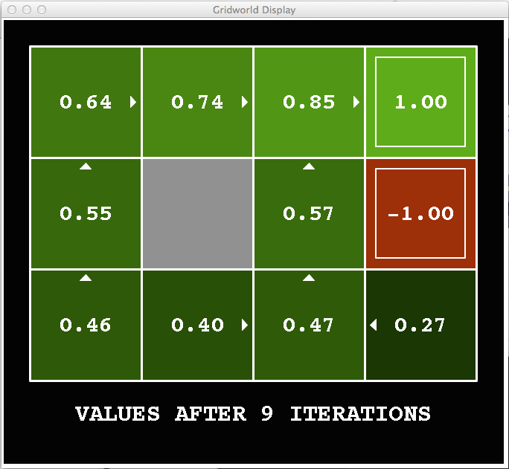
k=9
Noise = 0.2
Discount = 0.9
Living reward = 0
Notes:
Assuming zero living reward

Slide 24

k=10
Noise = 0.2
Discount = 0.9
Living reward = 0
Notes:
Assuming zero living reward

Slide 25

k=11
Noise = 0.2
Discount = 0.9
Living reward = 0
Notes:
Assuming zero living reward

Slide 26
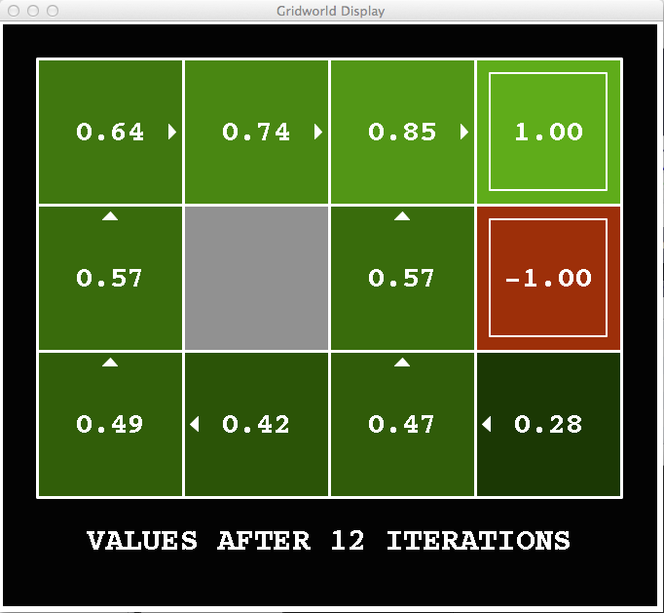
k=12
Noise = 0.2
Discount = 0.9
Living reward = 0
Notes:
Assuming zero living reward

Slide 27

k=100
Noise = 0.2
Discount = 0.9
Living reward = 0
Notes:
Assuming zero living reward

Slide 28
Let’s write some code
Gridworld Value Iteration Agent

